Slide 1
Everything you wanted to know about AAC in Schools
PRESENTERS: SARA STEWART, M.S. CCC-SLP, NBCT, LAMP Certified Professional
TAYLOR KORSON, M.S., Special Education Teacher, NBCT

Slide 2
Financial/ Nonfinancial Relationships
Presenters have no relevant financial relationships to disclose
Presenters have no relevant non-financial relationships to disclose

Slide 3
Learner Objectives
Identify three different ways to obtain an AAC device
Write an AAC IEP goal
Integrate AAC strategies into classroom activities
Notes:
TAYLOR
POLL: How comfortable are you with AAC

Slide 4
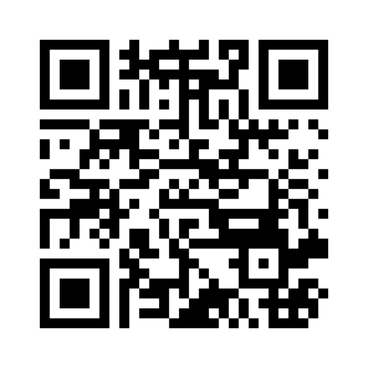
SCAN ME!

Slide 5
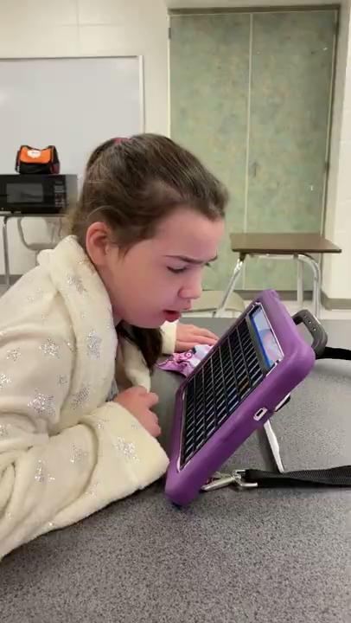
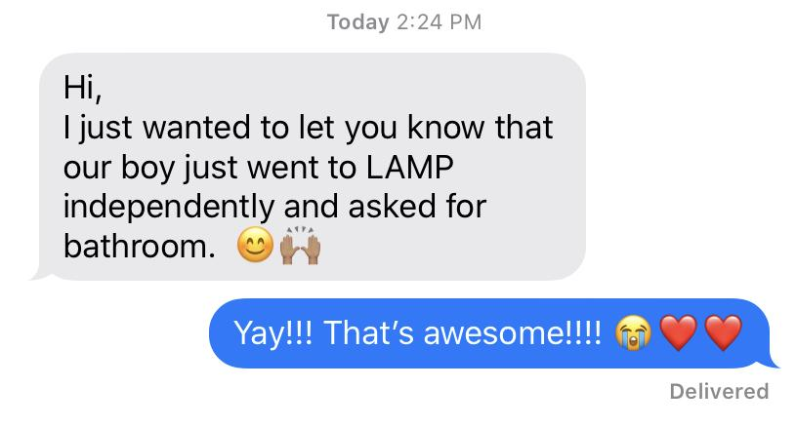
WHY?
To give students a voice
Increase independence
Decrease negative behaviors
Notes:
TAYLOR

Slide 6
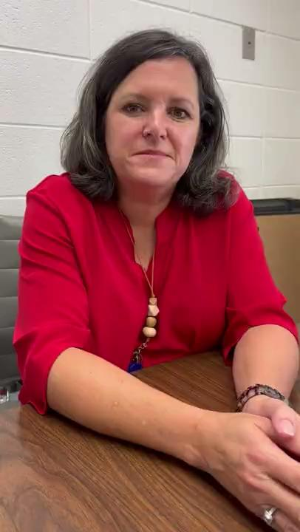
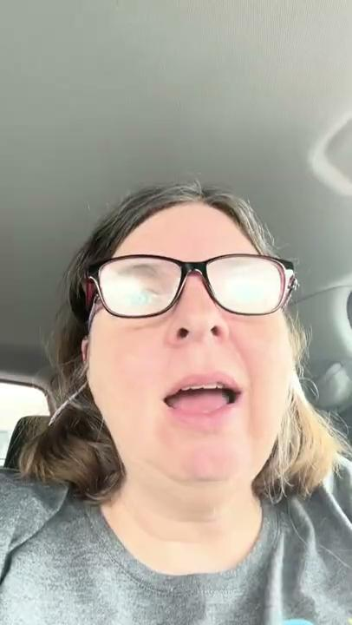
Teacher and Staff Buy-in
Notes:
TAYLOR
Teacher video (left): other methods took a lot of work, cognitive demand, SLP had to share more than once
Para video: She saw it work then bought in; now has high expectations

Slide 7
Parent Buy-in
“When my child first got her talker I thought there was no way she would be able to navigate it. There were so many icons that opened up to other icons. With just a little practice, she caught on so quickly and loves it! Now, I can give her a word and she is able to find it with ease and teach me! It has been very helpful and important for my daughter to be able to get her feelings and thoughts out with her AAC when she has difficulty expressing her emotions verbally.”
-Parent of current 9th grade AAC user
Notes:
SARA
This is a parent’s perspective

Slide 8
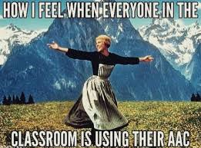

Slide 9
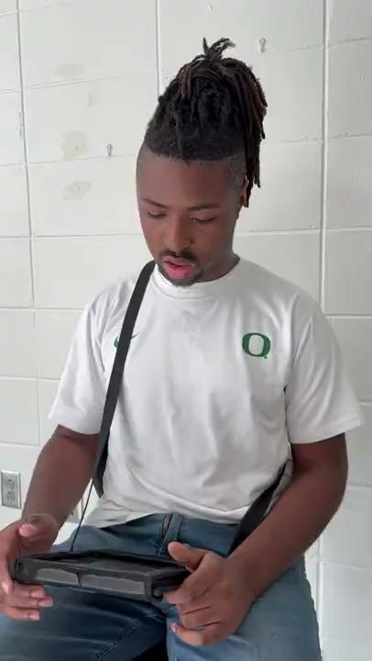
Student Buy In
Notes:
TAYLOR

Slide 10
Getting Buy-in
Teaching the child
Training staff
Baby steps/ One thing at a time
Parent grace
Notes:
SARA
So how do we get buy-in from staff? I start with teaching the child
Just modeled with my student last year who was device resistant
Asking why and giving grace

Slide 11
How to get AAC in School
Insurance
CRS
United Ability
You (With the help of outside device representatives)
Comes with device support, warranty, durable
School iPad purchase with app
Different rules in different districts
Advocate
apps half off in October and April
Parent purchase iPad out of pocket
Grants/ Donors Choose
Vocational Rehabilitation Services
Medicaid Waiver
Notes:
SARA
medicaid waiver *you can get placed on the waiver at 3

Slide 12
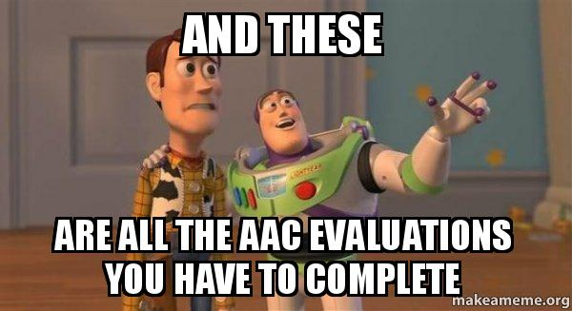

Slide 13
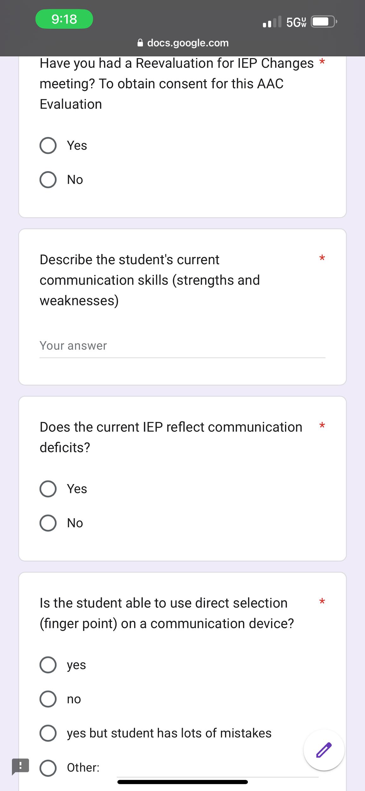
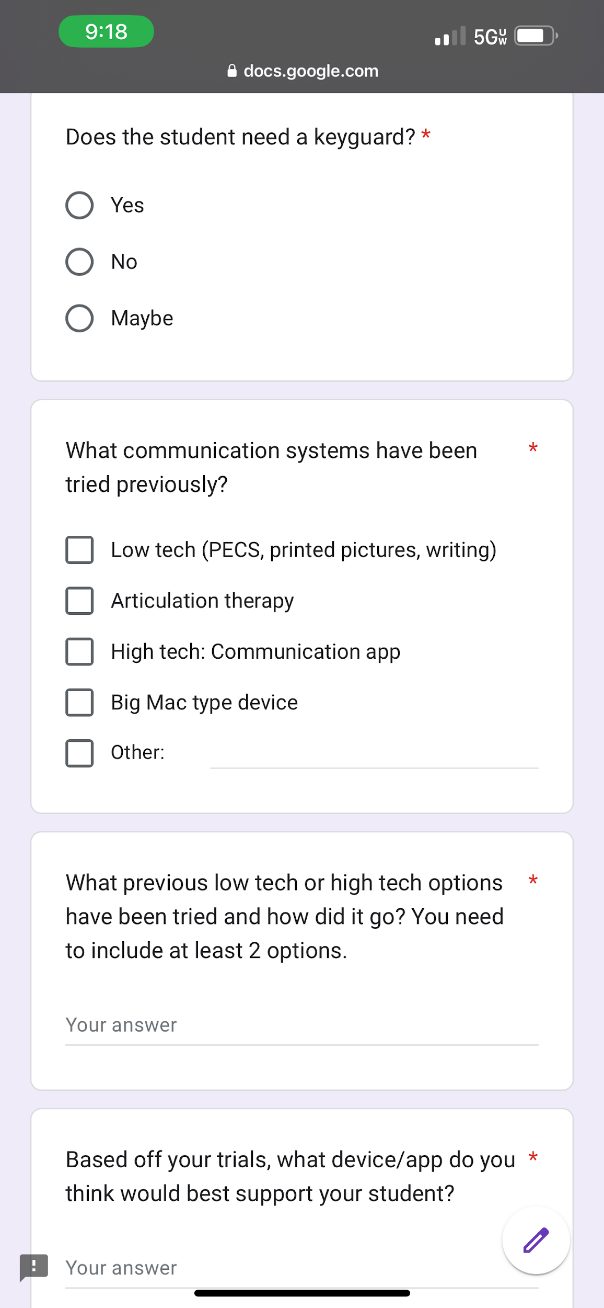
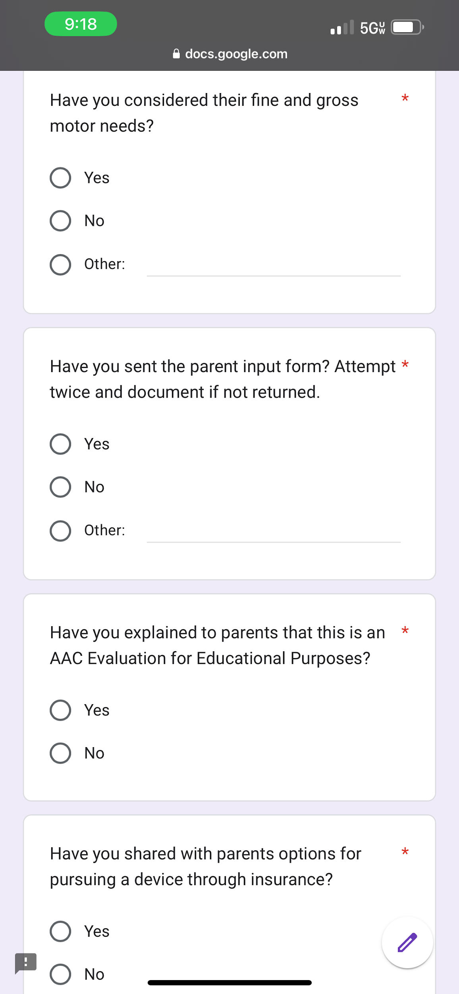
AAC Evaluation Google Form
Notes:
SARA
Information from some awesome SLPs in Huntsville and insurance reports

Slide 14
How to decide which AAC
Only prerequisite is….
Robust language
Keyboard
Environment
Specific Language System First Approach
Fine motor needs
Notes:
SARA
Amazing podcast called “Talking with Tech”

Slide 15
Limiting Vocabulary
Notes:
SARA
Student *fart*

Slide 16
Quick Check- Scan Me!
Notes:
TAYLOR
Pause and think
POLL:

Slide 17
AAC Goals
Evaluate where they currently are and where you want them to go
AAC Data Collection
Use ELA standards (gen ed, AAS, or transition)
AAC is sometimes just a language goal with a device
Notes:
TAYLOR

Slide 18
AAC Data collection
Word list for teacher/para to highlight when a student says a new word
Realize Language
Language screener from AAC Language Lab
Data collection sheet for prompting levels
DAGG-3
Notes:
SARA
Different ways to collect data
Realize language is a great online data collection system

Slide 19
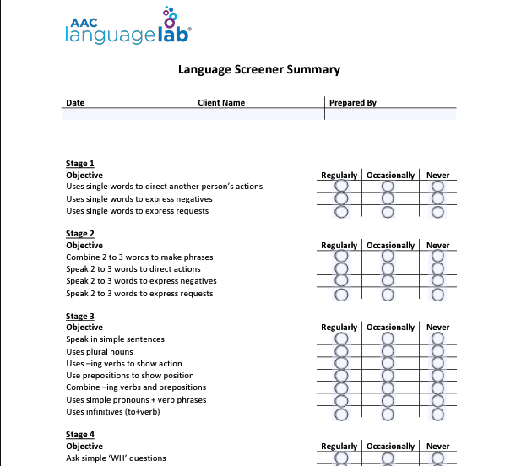
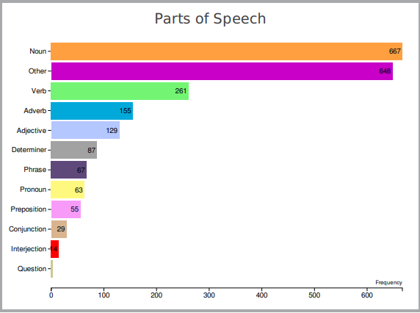
AAC Data collection
Notes:
SARA
*Add excel AAC prompting level data

Slide 20
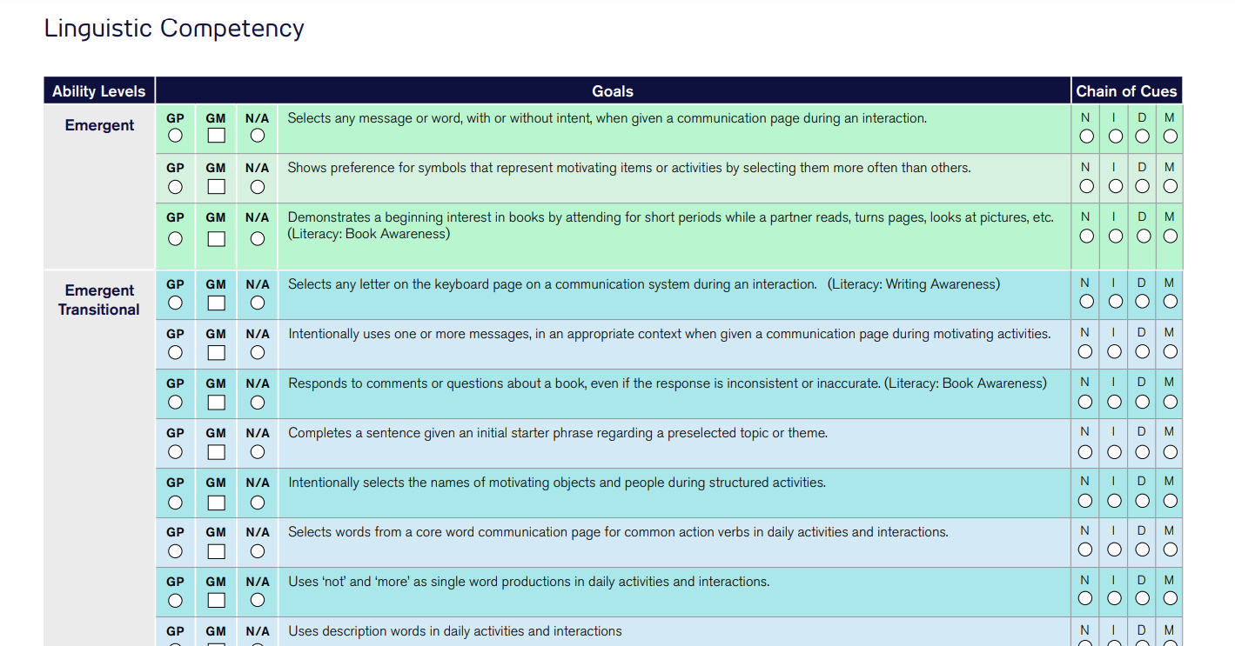
AAC Data collection
Notes:
SARA
With AAC, it’s not a “are you right or are you wrong”
Physical prompt- hand elbow movement
NO Hand over hand. That is compliance not communication

Slide 21
Types of AAC Goals
Operational
Turning the device on/off
Change volume
Password
Linguistic
Language
Using different language functions: requesting, protesting, commenting
Social
greeting, asking social questions, telling a joke
Strategic
repairing communication breakdown, using compensatory strategies
Notes:
SARA

Slide 22
Example AAC Goals
Operational
By May 2024, Student will enter his passcode on his device in 4 out of 5 opportunities with verbal prompt.
Linguistic
By May 2024, Student will use two words together in 4 out of 5 opportunities given a verbal prompt.
Social
By May 2024, Student will greet others 4 times during a 9 week period.
Strategic
By May 2024, Student will repair a communication attempt in 2 out of 3 opportunities given a gestural prompt.
Notes:
TAYLOR
LAMP book, Lingraphica website

Slide 23
Using AAC in the classroom
Different language functions/ opportunities
Morning meeting
Snack
Reading
News2You
PE
A/C Unit
Restroom
Notes:
TAYLOR
AAC Language Lab

Slide 24
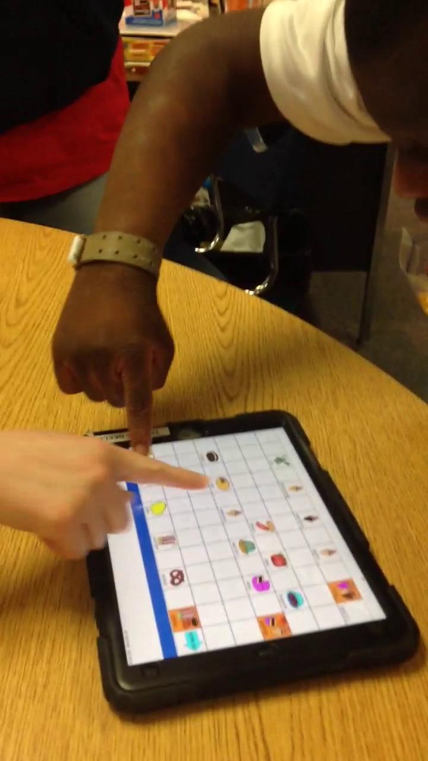
Requesting
Notes:
TAYLOR
0:04-0:35
This was during a group activity of making Trail Mix. Used open ended questions. Instead of “tell me candy corn”, asked “What do you want?”

Slide 25
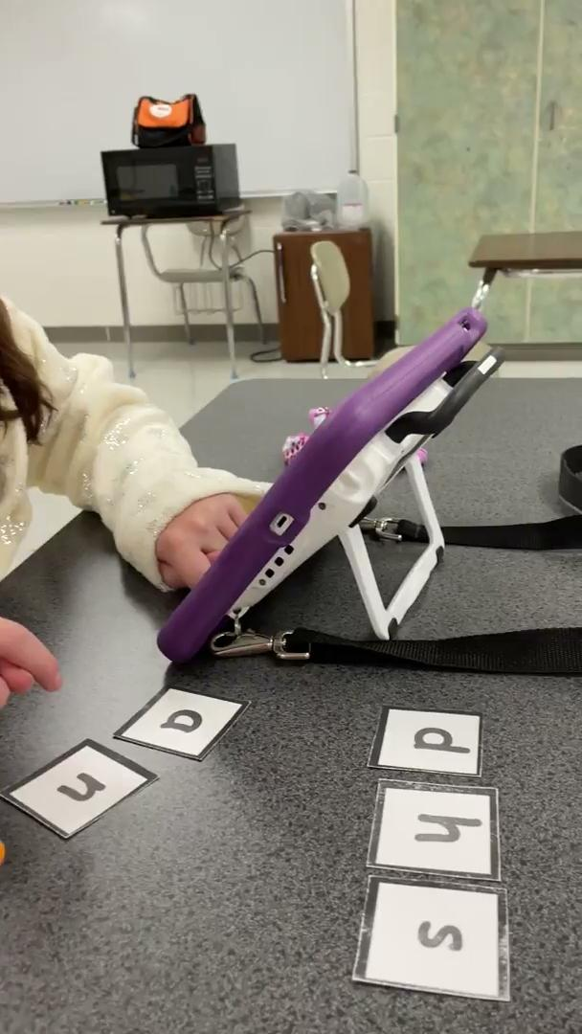
Reading
Notes:
Video is from a great reading curriculum called “Getting Ready to Read” from the AAC Language Lab website

Slide 26
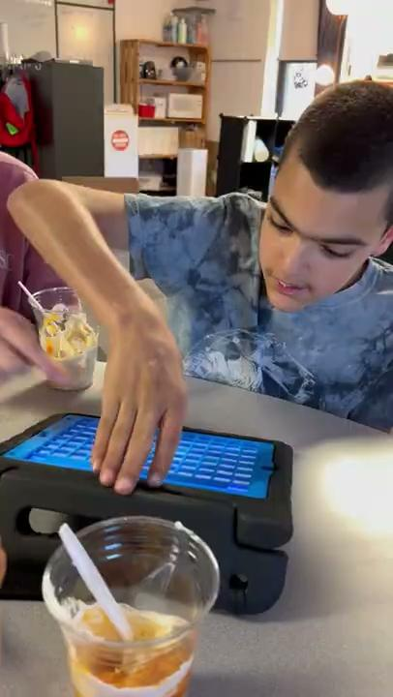
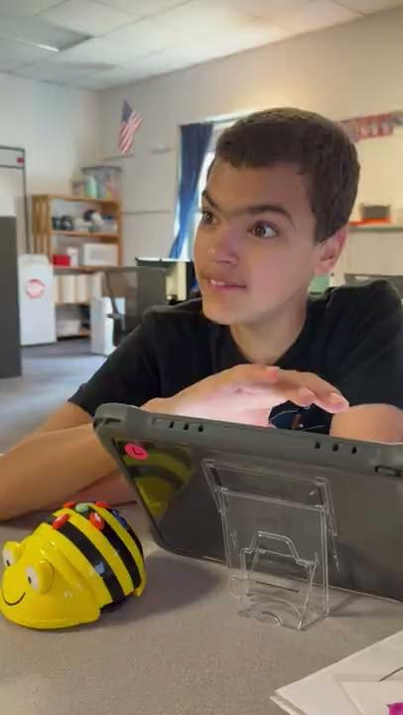
Commenting/ Coding
Notes:
SARA
Left video: Used Word Finder
Right video: Full field independently

Slide 27
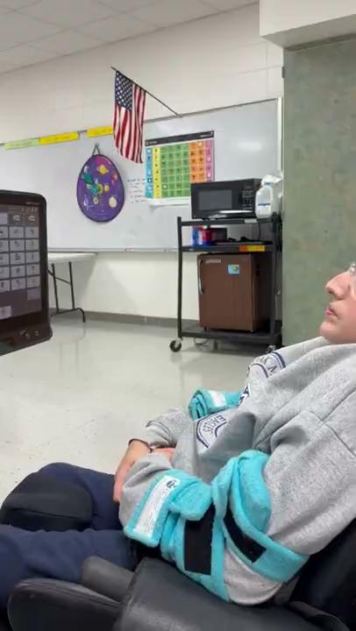
Telling a Joke
Notes:
SARA
Why didn’t the teddy bear eat his dinner?
He was “stuffed”

Slide 28
Quick Check- Scan Me!
Notes:
TAYLOR

Slide 29
Groups
Individual
Small group
with other AAC users
Whole group with non AAC users
Notes:
SARA

Slide 30
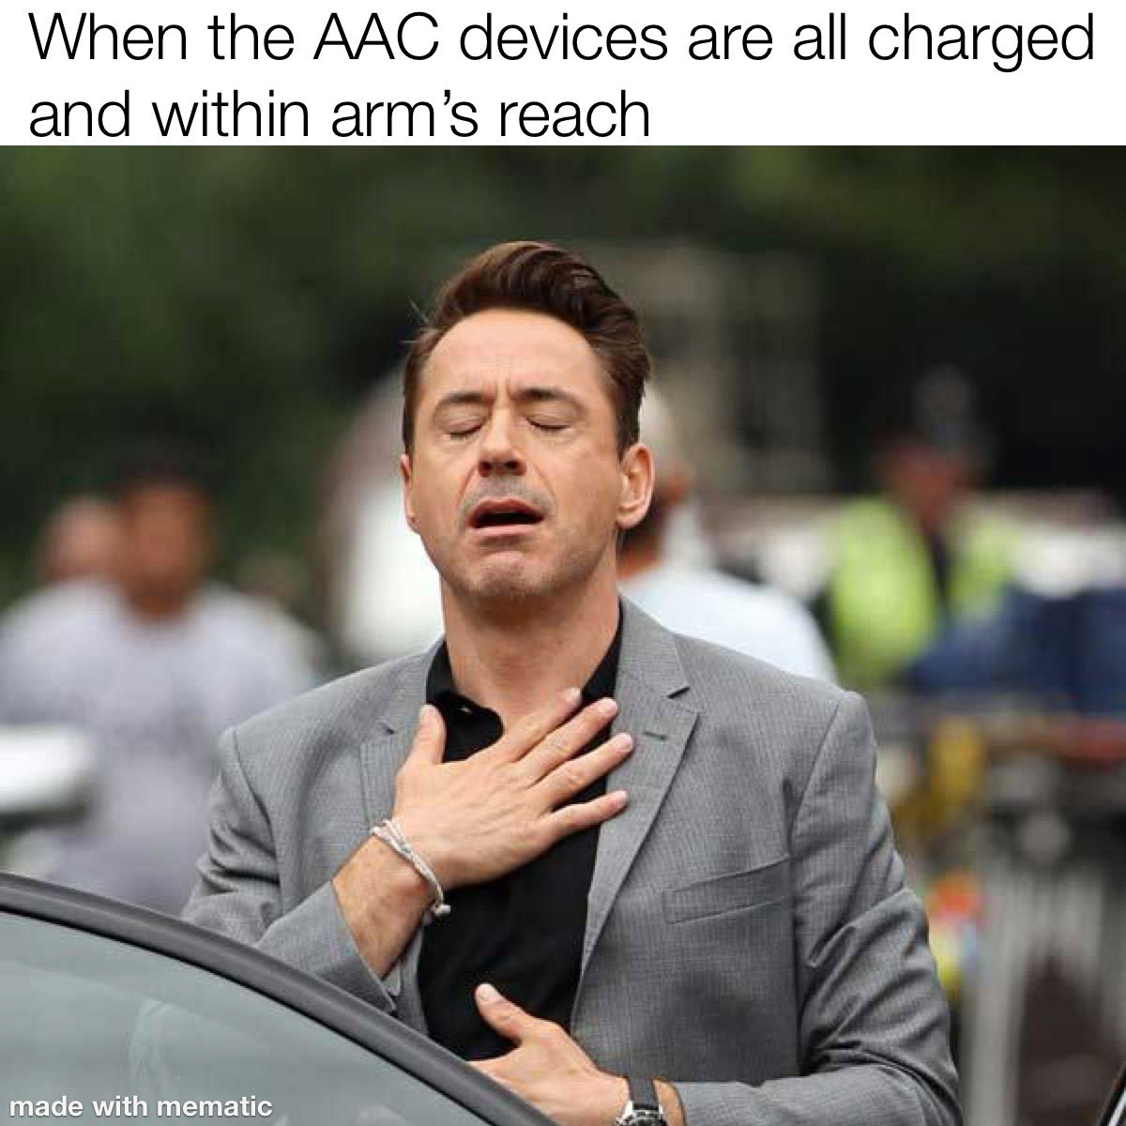

Slide 31
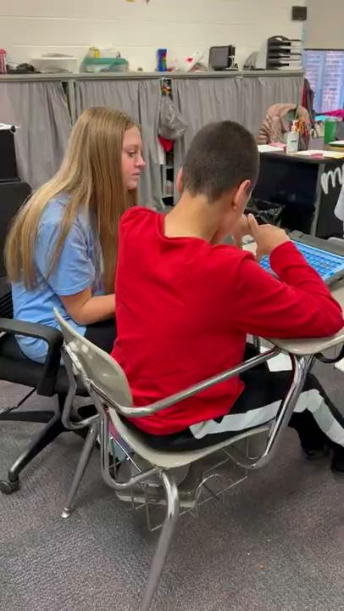
Peer helpers
Notes:
TAYLOR

Slide 32
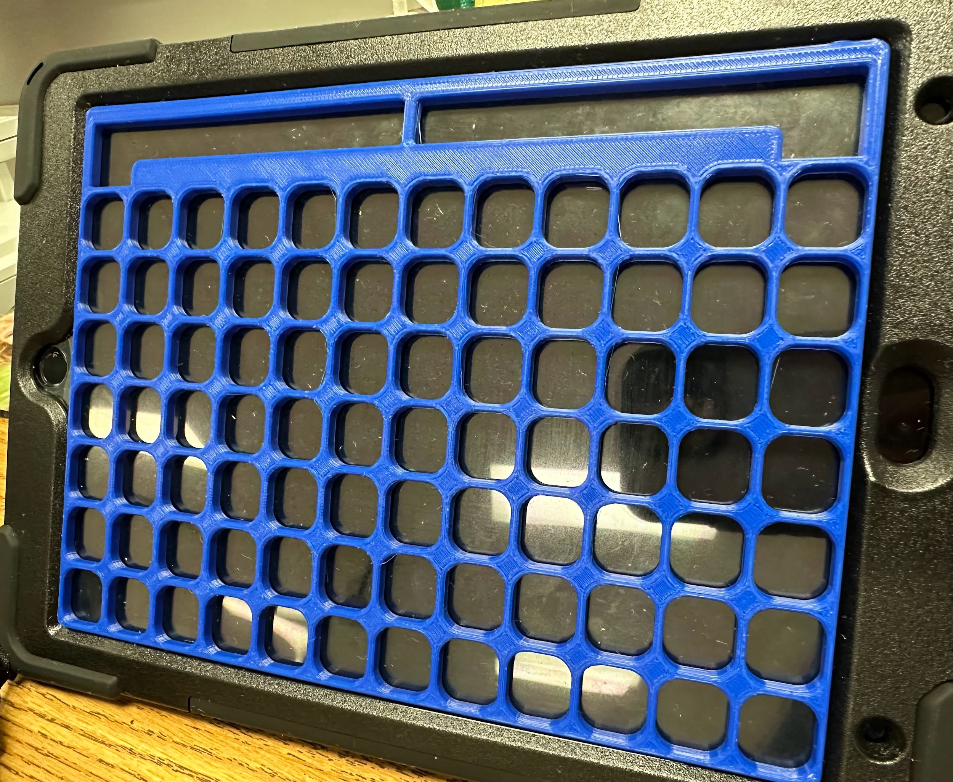
3D Printer Keyguards
Notes:
SARA

Slide 33
Helpful Outside Providers
PRC Saltillo representative: Melissa Pouncey
melissa.pouncey@prc-saltillo.com
Tobii Dynavox representative: Tiffani Powell
Tiffani.powell@tobiidynavox.com
Children’s Rehabilitation Services
(334) 293-7500
Notes:
SARA

Slide 34
AAC Data collection/evaluation
DAGG-3
https://us.tobiidynavox.com/pages/dagg-3-resources
AAC Language Lab
https://aaclanguagelab.com/language-screener
subscription needed for online version
Reading curriculum: https://aaclanguagelab.com/curriculums
Realize Language
https://realizelanguage.com/info/
Types of AAC Goals
https://lingraphica.com/clinical-guides/therapy-and-treatment/aac-device-goal-setting/
Notes:
SARA
Discuss the cost

Slide 35
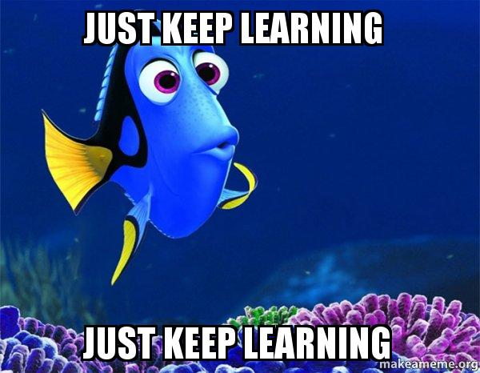
Training
Empower software- LAMP on your computer
https://www.prentrom.com/prc-advantage/empower-demo
Free short trainings
https://www.prentrom.com/education/classes?type=master_the_technology&method=on_demand
PRC: AAC Learning Journey
Tobii Dynavox: Learning Hub
Longer LAMP trainings
https://www.aacandautism.com/training
AAC topics
https://minspeak.com/education/
ion/
Notes:
Taylor

Slide 36
References
www.aacandautism.com
Talking with Tech podcast
Episode 235: Specific Language System First Approach
Shout out to the knowledge shared by United Ability, CRS, and Huntsville area SLPs, PRC& Tobii Dynavox representatives
AAC Goals: https://lingraphica.com/clinical-guides/therapy-and-treatment/aac-device-goal-setting/
Clip Art: Drawn to AAC on Teachers Pay Teachers
Memes: https://twitter.com/AACing_it/status/1506074688342134794
https://makeameme.org/
Notes:
SARA

Slide 37
Any questions? Email us!
Sara Stewart, Speech Language Pathologist
s3stewart@shelbyed.org
Taylor Korson, Special Education Teacher
tkorson@shelbyed.org
Notes:
TAYLOR

